Slide 1


System Overview and Background

Slide 2
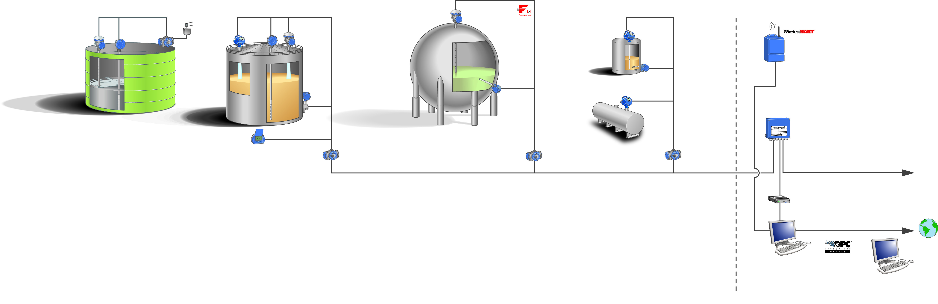
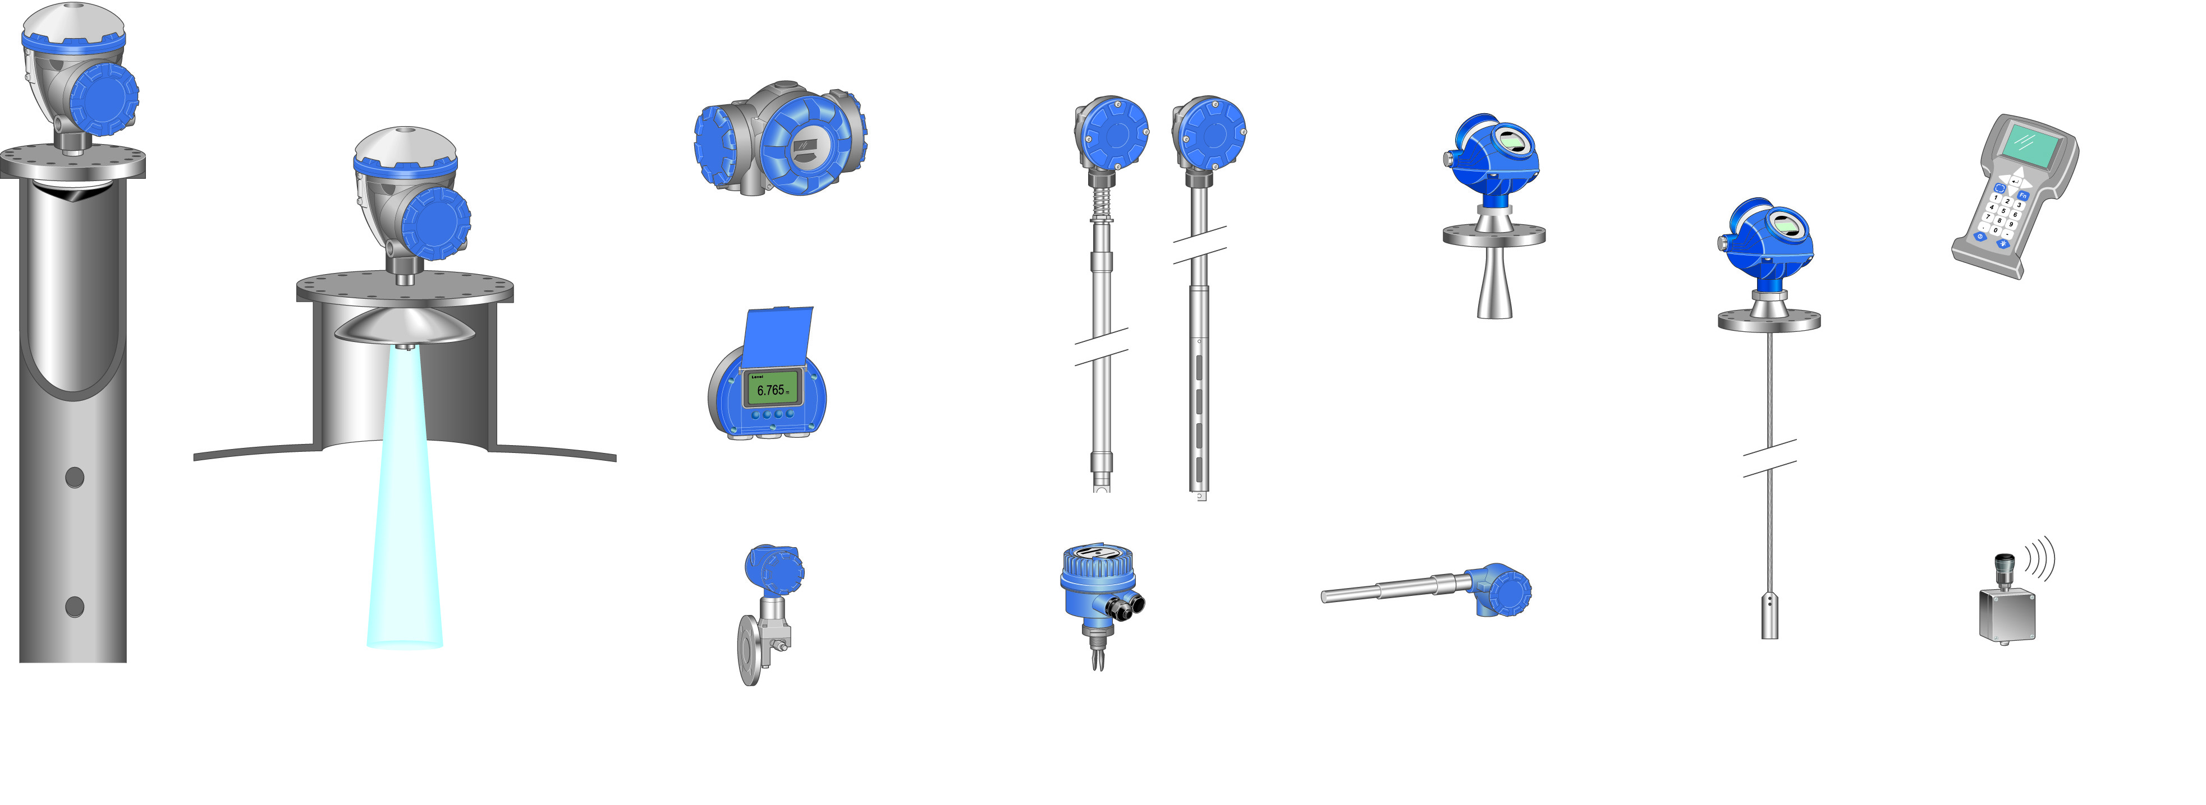
Rosemount Raptor System
THUM
2240S
5900S
5400
5900S
2240S
5400
5900S
2410
644
Smart Wireless Gateway
3051S
5300
644
Mini Receiver / Field Communication Unit
2230
2410
2410
2410
2180 Field Bus Modem
2240S Multi-input Temperature Transmitter
5900S Radar Level Gauge
5300/5400 Radar Level Transmitter
Field Communicator
TankMater PC Workstation in Network
2410 Tank Hub
TankMaster.net
2230 Graphical Field Display
Smart Wireless THUM Adapter
644 Temperature Transmitter with Single Point Temperature Sensor
3051S Pressure Transmitter
2120/2160
Liquid Level switch
Notes:
Raptor system.

Slide 3
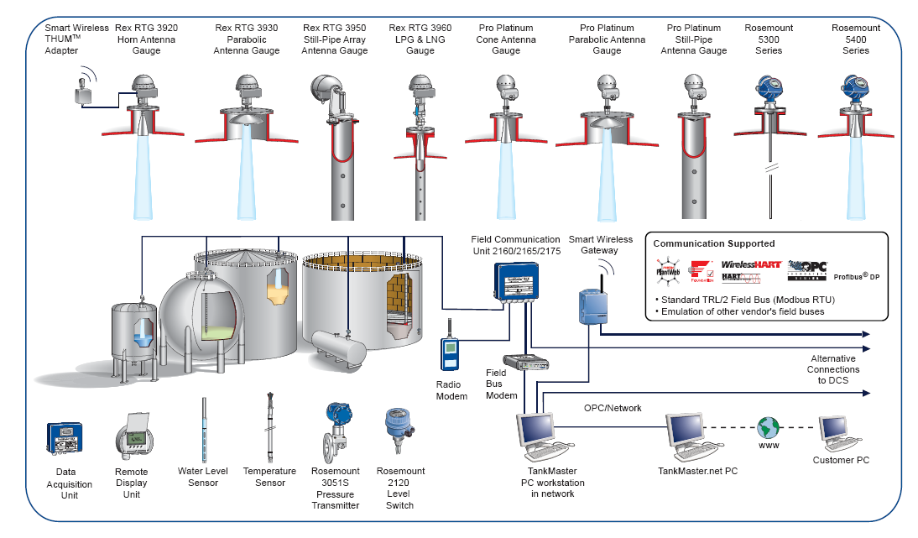
Rosemount Rex/Pro System
Notes:
Rex system.
Same FCU, FBM, Wireless GW/THUM, 3051, 2120.

Slide 4
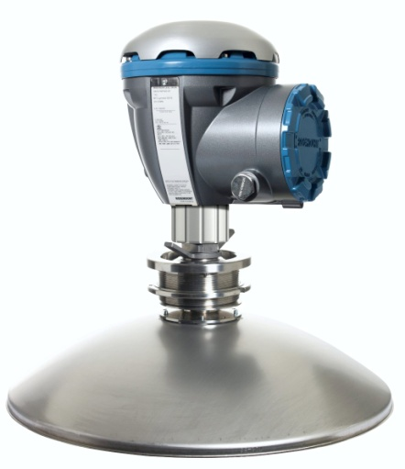
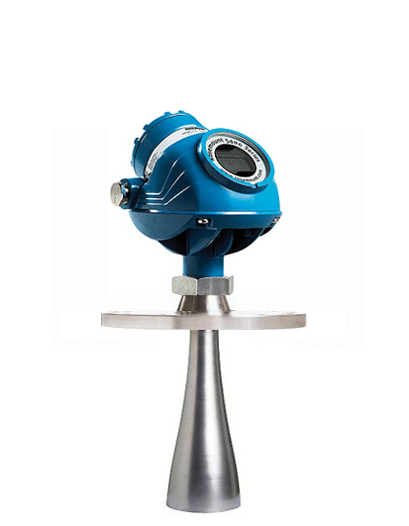
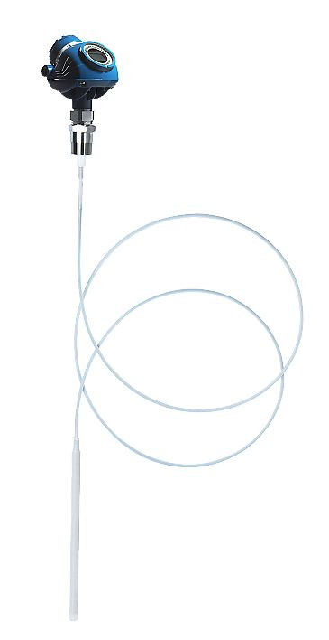
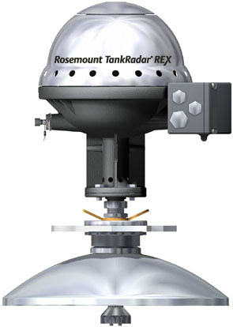
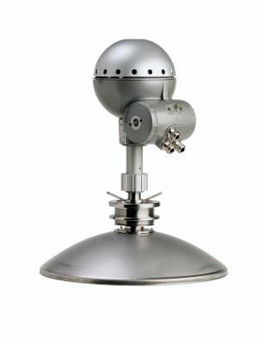
Rosemount Radar Gauges
Inventory Tank Gauging
High Accuracy
Operational Control
Lower accuracy
Notes:
Available gauges today. Also 3300 but 5300 has replaced that one.
In the future; Rex and Pro will disappear and Raptor will be the only high accuracy gauge.

Slide 5
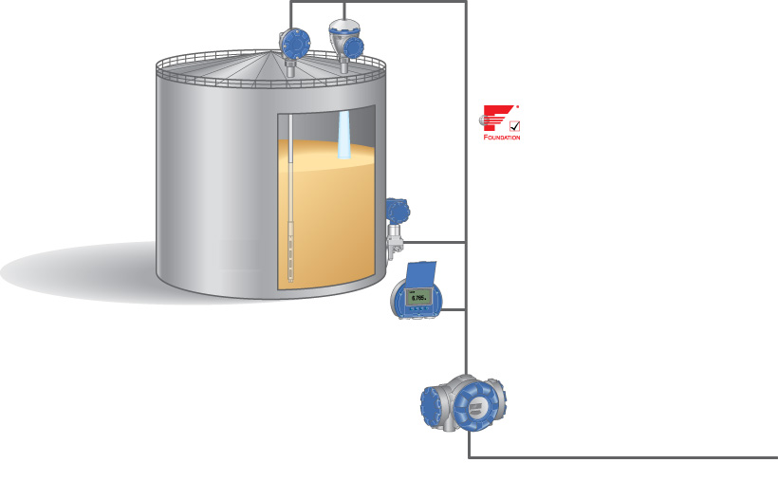
Raptor System Configuration
2240S Multi input Temperature Transmitter
5900S Radar Level Gauge
Tankbus: FOUNDATIONTM fieldbus
3051S Pressure Transmitter
2230 Graphical Field Display
2410 Tank Hub
Fieldbus
Notes:
Start with the Raptor system solution.
Different from the Rex system; FF tank bus, Tank hub communicates wtih host. All devices are daisy chained on the tank bus.

Slide 6
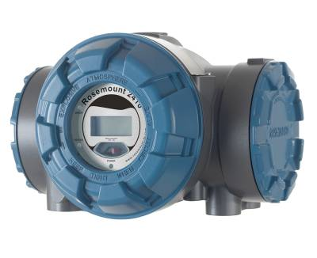
2410 Tank hub
Collects measurement data
Calculates
Avg temp
Observed density
Volume
Communicates tank data to host
Autoconfiguration of the tank bus
Display
Optional
Notes:
Tank hub collects data from all tank devices and communicates them to the host.
Autoconfiguration: Devices have built-in communication modems for FISCO FF communication and will auto communicate with the tank hub when connected to the tankbus.

Slide 7
2410 Tank hub
Feeds IS power to the tankbus
Two versions
Single tank
Multiple tanks
Opens up for
Output Relay functionality
Wireless Tank Gauging
Emulation
Notes:
Tankbus carries both data transmission and power supply.

Slide 8
Rosemount 5900S
5900S Radar Level Gauge
±0,5 mm instrument accuracy
10 GHz FMCW
Custody Transfer approved
High temperature stability
SIL 2 and SIL 3 certified
2-in-1 function
Communication and power daisy-chained on the Tankbus
Notes:
Temperature stability: <+/- 0.5mm (0.020 in) in the range of -40° and 70° C (-40° and 158° F)

Slide 9
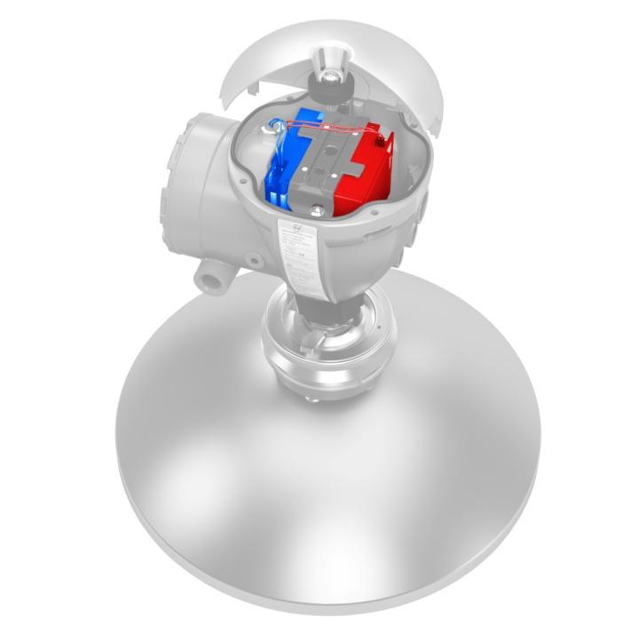
5900S 2-in-1 function
2-in1- means:
one housing
one antenna
two electronic units
One primary
One secondary
Features and benefits:
High level alarm
Redundancy
SIL 3
Two independent electronic units

Slide 10
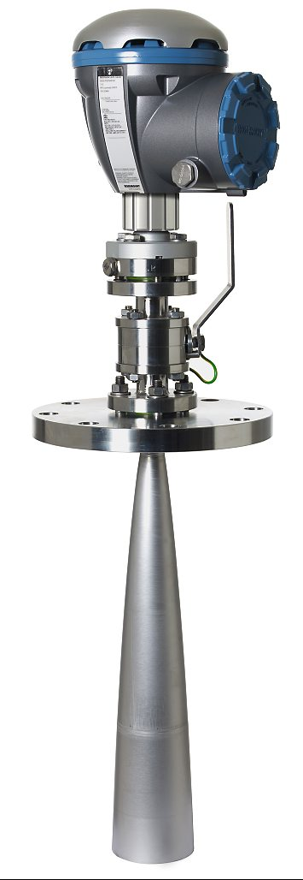
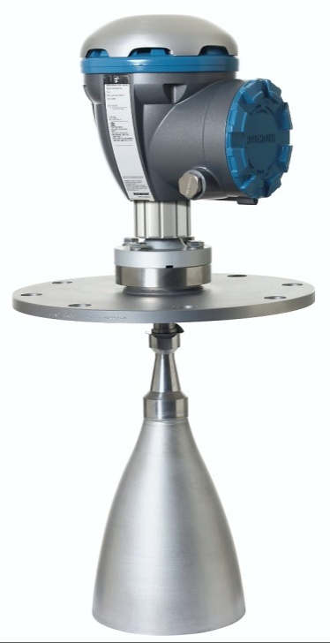
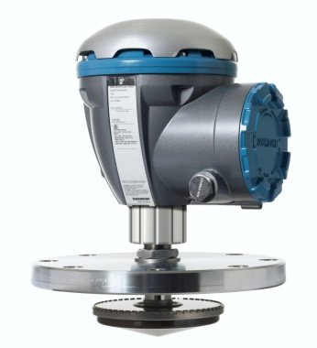
5900S Antennas
Array
Parabolic
Horn
LPG/LNG

Slide 11
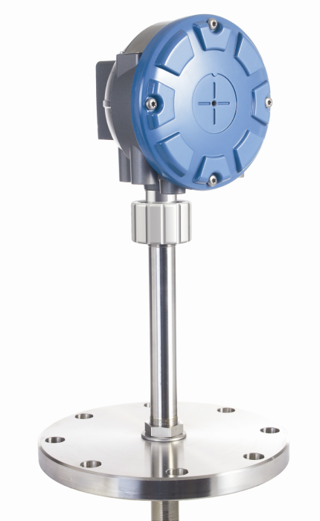
2240S Multi-input Temperature Transmitter
Up to 16 sensors
3- and 4-wire
Improved accuracy
Integrated Water Level Sensor (WLS)
Installed
directly on top of MST/WLS
remotely on a pipe or wall
Intrinsically safe
Custody transfer approved
Notes:
Less than 0.05° C drift in a range of -200° and 250°C (-324° to 482° F)
Rex has +/- 0.1°C drift on the same range
3-wire common return
3-wire individual spot
4-wire individual spot

Slide 12
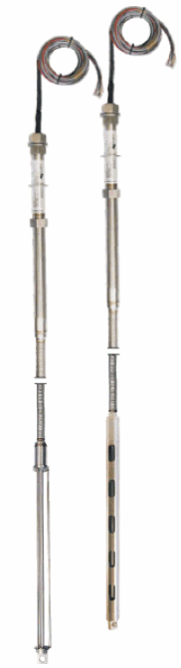
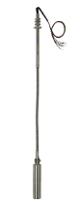
Multi Spot Temperature Sensor and Water Level Sensor
Three types of Multiple spot temperature sensors (MST)
565, 1-16 PT100 spot elements
566, for cryogenic applications
765, Integrated Water Level Sensor (WLS)

Slide 13
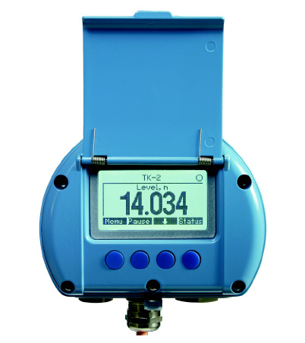
Rosemount 2230 Graphical Field Display
Displays tank data
Level
Temperature
Pressure etc
Several displays may be connected on one fieldbus
Custody Transfer Approved
Intrinsically Safe
Backlit
Notes:
Possible to configure 3 displays in TM, but possible to configure more on the same tank bus with buttons in field
Backlit display, big improvement from before.

Slide 14
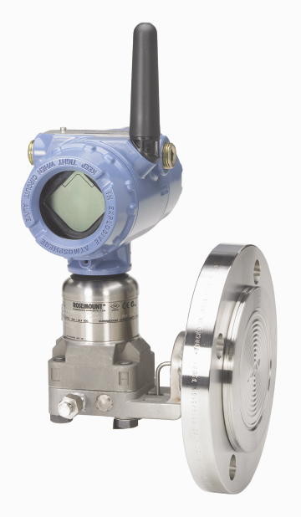
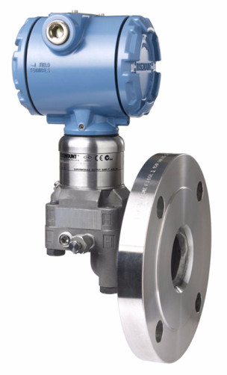
3051S Pressure Transmitter
Measures vapor and liquid pressure (density)
0.025% accuracy
Variety of transmitters and flanges
Suitable for all kinds of applications and tanks
Crude oil tanks
Pressurized tanks
Floating roof tanks etc.
Notes:
Recommended pressure transmitter for Raptor Hybrid systems.
Supplies the measured pressure data to the FF tankbus. Powered by the tank hub.
The 3051S series consists of transmitters and flanges suitable for all kind of applications.
Also available wireless (WirelessHART) with the same outstanding performance.

Slide 15
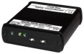

Raptor Tank Gauging System

Slide 16
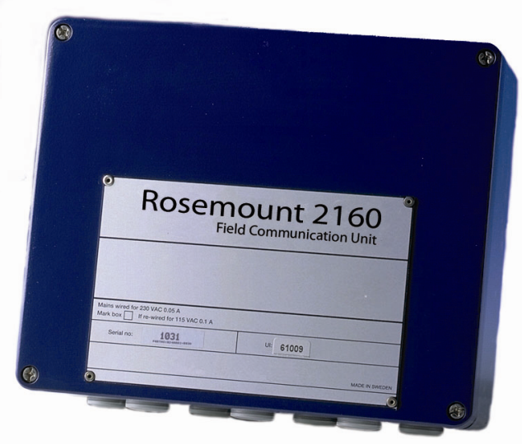
2160 Field Communication Unit
Collects data from field devices (2410 tank hub, Rex, Pro)
Stores data in buffer
Improves update rate from field devices
No explosion proof protection
Mounted in a non-hazardous area
TRL2 Modbus / RS485
RS232
Notes:
This is how to integrate the Rex and the Raptor system.
FCU collects data from field devices and stores the data in a buffer memory. Whenever a request is received from a host, the FCU can immediately send data from the updated buffer memory.
Six slots (communication ports) for interface boards TRL2 or RS485. Two of the slots can also be configured as RS232.
Each radar level gauge or tank hub has an individual address on the fieldbus.
Maximum number of tanks for one FCU is 32.

Slide 17
Rosemount Rex 3900-series
3900-series Radar Tank Gauge
±0,5 mm instrument accuracy
10 GHz FMCW
Custody Transfer approved
SIL 2 certified
4 wire
2 bus, 2 power

Slide 18
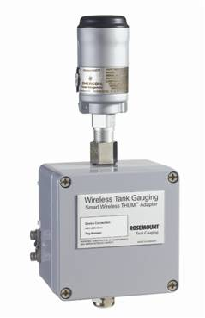
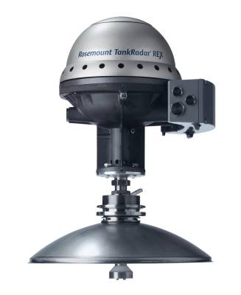

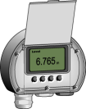

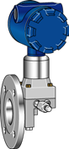
Rex Inputs and Outputs
SDAU
RDU
THUM
2 X Relay
4-20 mA
Communication bus
Rosemount TRL/2
RS-485 Modbus
Foundation Fieldbus
Profibus DP
Emulation
Enraf
Sakura
L&J
Varec
Whessoe
Tiway
GPE
GSI
Temp
sensors
maximum
14 spots
PT 100
Temp
sensor
maximum
6 spots
PT 100
Pressure
Sensor
4-20 mA
Input
or
3 x HART
Water bottom
sensor
4-20 mA Input
Notes:
Not possible to have SDAU and RDU at the same time, although 2xRDU is possible.
Everything that goes into the Rex gauge, connects to the Tank hub in the Raptor system, such as; Pressure, temp & Water level sensor (via 2240S) .
Same goes for outputs, such as relay outputs, emulation interface display etc.

Slide 19
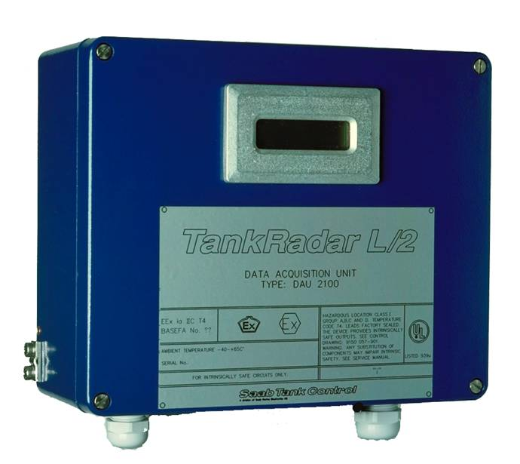
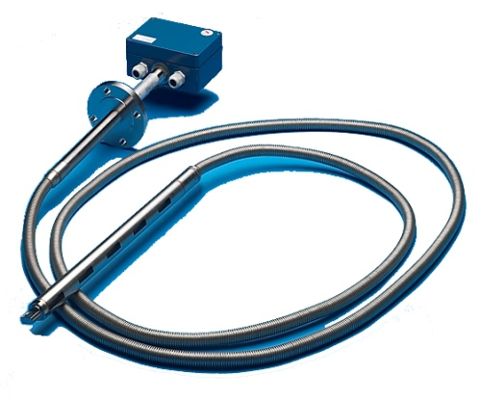
Slave Data Aquisition Unit
Slave DAU
Used together with REX when more than 6 temp spots are needed.
Maximum 14 temp elements
Local display as option
Intrinsically safe
Connects directly to REX
Multiple Spot Thermometer
Immersed sensors are used, Max 14 elements
Anchor weight
Water Level Sensor
Integrated with MST
Capacitive

Slide 20
Rosemount PRO
Rosemount PRO
±3 mm instrument accuracy
10 GHz FMCW
4 wire
2 bus, 2 power

Slide 21
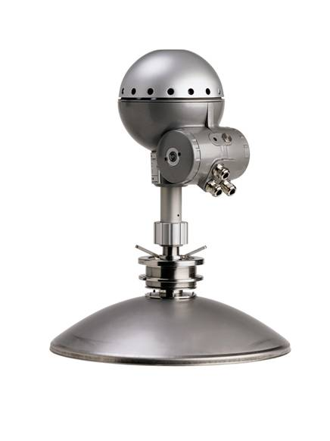

PRO Inputs and Outputs
Input
Output
Temp input card
in DU 2210
DU 2210
THUM
Communication bus
Rosemount TRL/2
Foundation Fieldbus
Profibus DP
Secondary 4-20 mA
Temp
sensors
6 spots

Slide 22
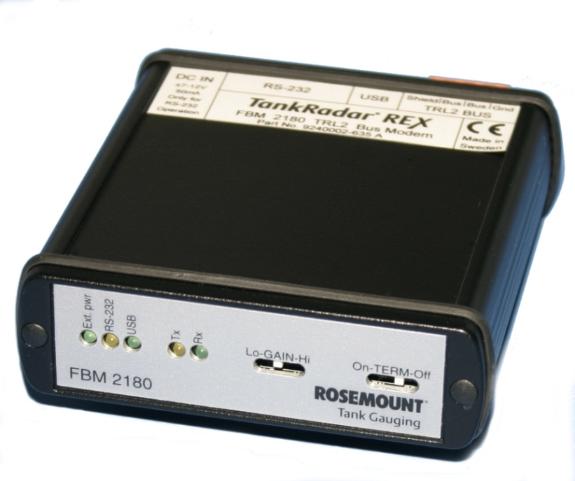
2180 Field bus modem
TRL2 to RS232 or USB converter
Non EX proof
Notes:
To connect the TRL2 fieldbus to TankMaster. Converts TRL2 to RS232 or USB.
Led’s indicating power on and communication.

Slide 23
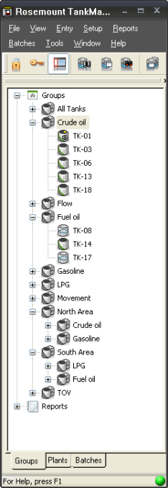
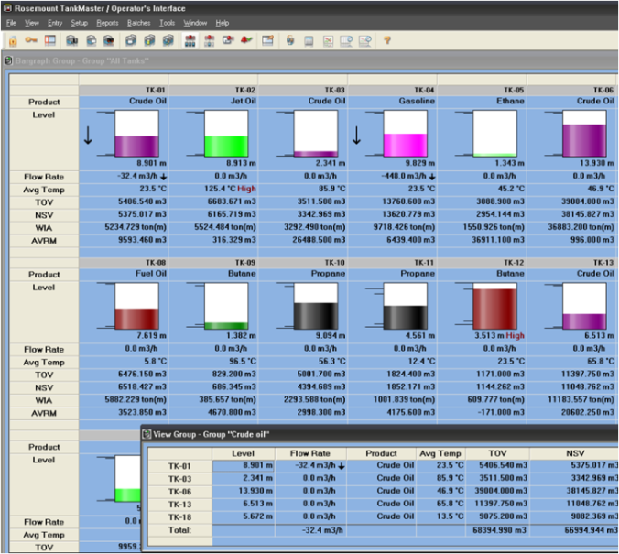
Rosemount TankMaster
Rosemount TankMaster features:
Easy to use
API tables included
Easily integrated with most host systems, ie DeltaV
Customized views
Easily translated to other languages
TankMaster consists of
WinSetup
WinOpi
WinView
TankMaster.net
Notes:
Inventory management software package. Designed and developed by Emerson.

Slide 24
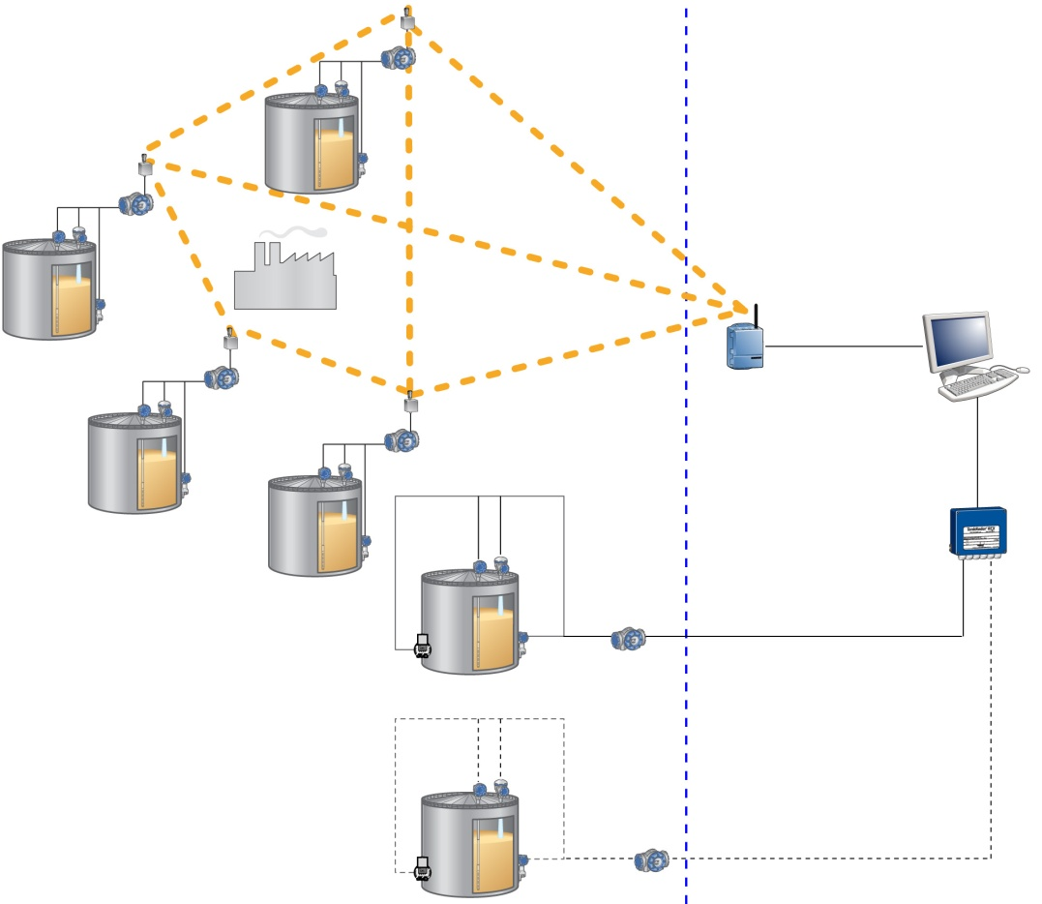


Wireless Tank Gauging
Emerson’s Smart Wireless solution
IEC 62591 (WirelessHART)
Easy to install
Reliable
Encrypted
Connect remotely located tanks
Combine Wireless and Wired systems
Field
Control room
Smart Wireless Gateway
TankMaster for inventory management
2160 Field Communication Unit
Notes:
The Raptor system supports Emerson’s Smart Wireless solution, based on IEC 62591 (WirelessHART), the industry standard for wireless field networks.

Slide 25

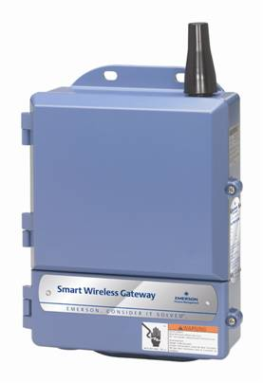
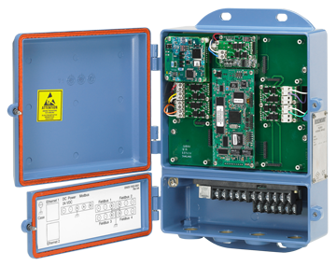
Smart Wireless Gateway
Smart Wireless Gateway
Network manager
Connects WirelessHART with any host system
Up to 100 nodes
Configured via AMS
Notes:
The gateway is the network manager in wireless systems. It connects the wireless network with any host system. The gateway itself can handle up to 100 nodes, however, in tank gauging we do not recommend more than 50 and if many variables are sent not more than 30 nodes per gateway.
Comes with a web interface that provides easy configuration of the network.

Slide 26
Smart Wireless THUM adapter
IEC 62951 (WirelessHART^{TM)} Interface to Tank Hub, Rex and Pro
Transmit up to 16 variables and status
Advanced configuration and Diagnostics
Configured via
AMS Wireless Configurator
375/475 Field communicator
Notes:
Wireless interface to the field device (Rex, Pro, Tank hub).
Up to 16 variables in Raptor, 8 with Rex (requires lates Rex Firmware 1.K1, otherwise only 4 variables)

Slide 27
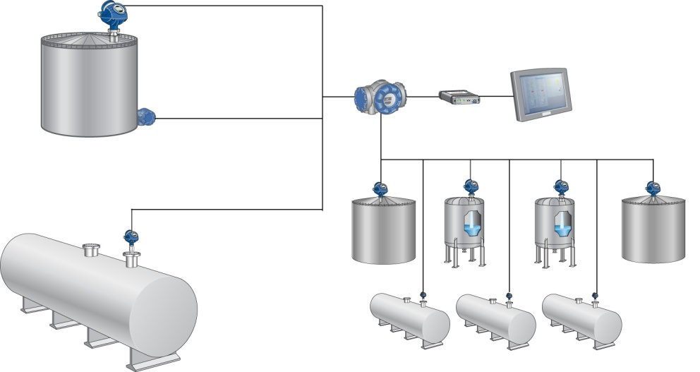

Operational Control
5300- or 5400 system configuration
5400 Level Transmitter
644 Transmitter / Rosemount 65 Single Point Temperature Sensor
2410 Tank Hub
TankMaster WinView
2180 FBM
5300 Level Transmitter
Notes:
In a system primarily intended for operational control, level and observed volume (TOV) are important paramters, but highest accuracy is not necessarily required.
The Raptor system includes the followiing equipment for cost-efficient measurement and calculations:
5300 / 5400 for level
644 with 65 for temp
TM winview

Slide 28
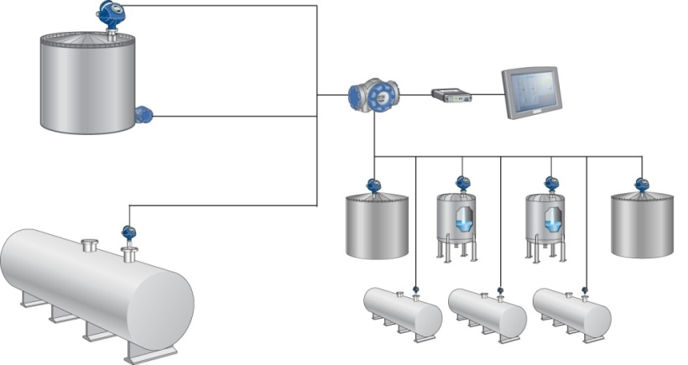
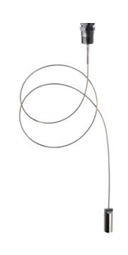
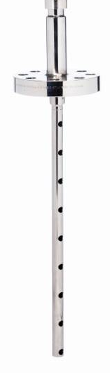
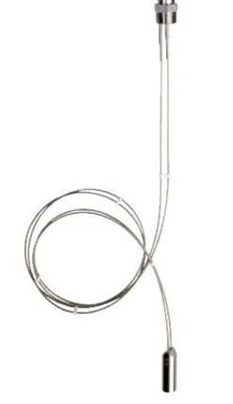
5300 Level Transmitter
Pulsed Guided wave radar
5301
5302
± 3 mm of reference accuracy
Suitable for operational control on liquids and slurries
Variation of probes
Coax
Single Flex
Twin Flex

Slide 29
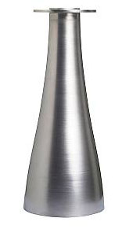
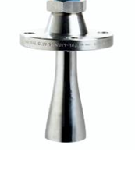
5400 Level Transmitter
5402
Pulsed radar
± 3 mm of reference accuracy
Suitable for operation control on liquids and slurries
Cone antennas in various sizes
2 – 4 inch
Notes:
5402 = 26 GHz

Slide 30
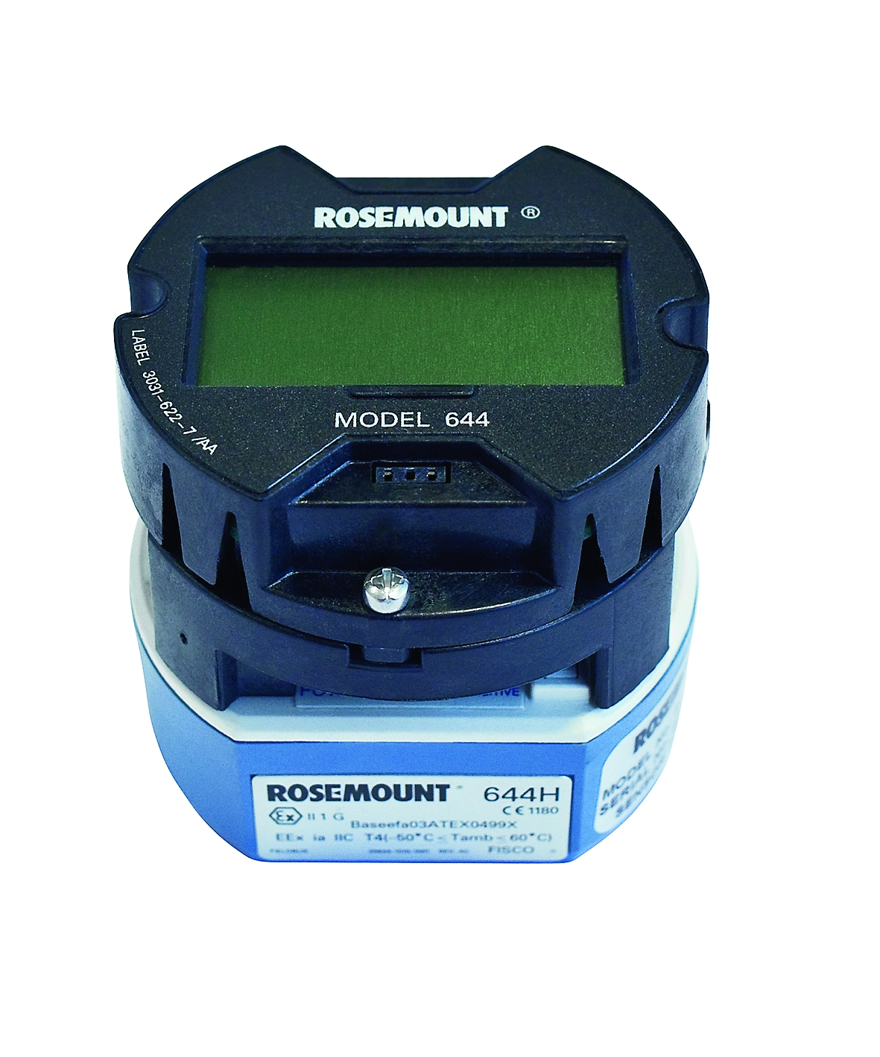
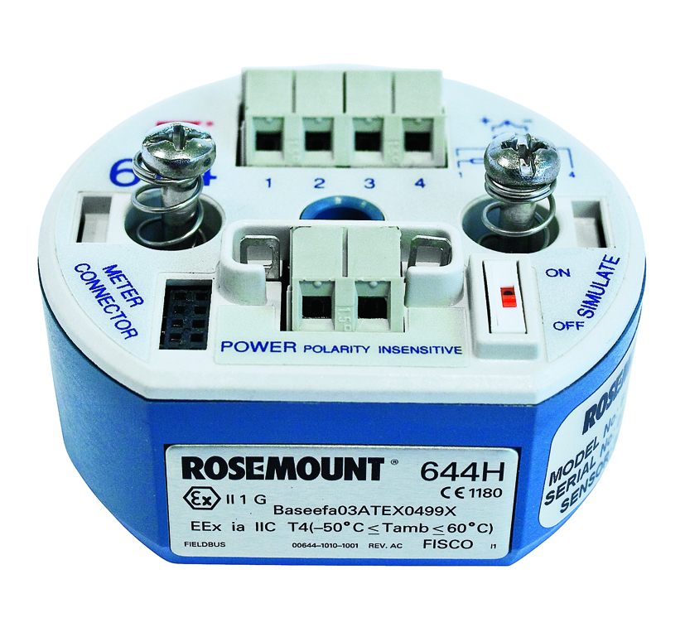
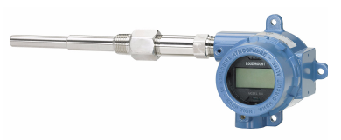
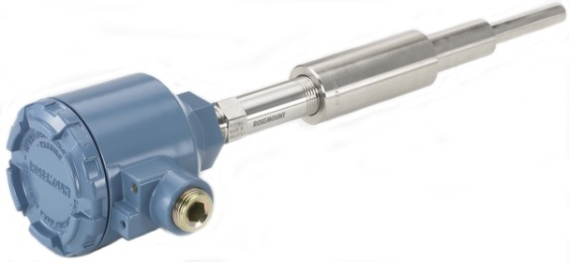
Rosemount 644 Single Point Temperature Transmitter
Single Point Temperature Transmitter
To be used
With Rosemount single spot temperature sensor
644 temperature transmitter unit
644 temperature transmitter unit with display option
644 temperature transmitter unit with single spot temp sensor
Notes:
Single Point temperature sensors are used in applications with lower requirements on volume measurements, or where it is not possible to use a multiple spot tempererature sensor due to installation restrictions (e.g. An LPG tank with thermowell)
The 644 Temperature Transmitter can be used with Rosemount single point sensors to transfer values on the tankkbus to the 2410 tank hub.

Slide 31
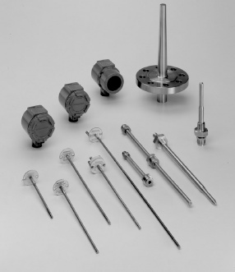
Single Spot Temperature Sensor
A selection of sensors are available
Integrated with 644 temperature transmitter
Pre-installed in thermowell
Connected with a flange or a thread
Notes:
A Rosemount 65 series single point temp sensor is ordered integrated with the 644 temp transmitter.
Can be ordered pre-installed in a thermowell.
Can be connected with a flange or thread.

Slide 32

TankMaster WinView
HW Key option
Displays live values and trends
Level
Temperature
Pressure
Free water level
TOV
Notes:
TankMaster WinView is a software package with basic inventory capabilities. It is a cost efficient alternative for operational control at smaller tank terminals, marketing terminals, biofuels and chemical plants etc. Configuration is made with WinSetup, which is included in the delivery.

Slide 33

SIL design for overfill protection
SIL = Safety Integrity Level
SIL 3
safety
Notes:
All refineries, tank farms and fuel depots have a responsibility to ensure that overfill incidents do not occur. Raptor is SIL 2 and SIL 3 certified for overfill protection according to IEC 61508-2 and 61508-3. The system provides reliable High-High level alarm functionality, based on a separate SIL 2- or SIL 3-rated relay function (see pages 16, 29, 89, and 91). Rosemount 5900S Radar Level Gauge with SIL option is configured to activate a separate alarm loop at a predetermined product level. The alarm loop triggers the safety relay output from the Rosemount 2410 Tank Hub.

Slide 34
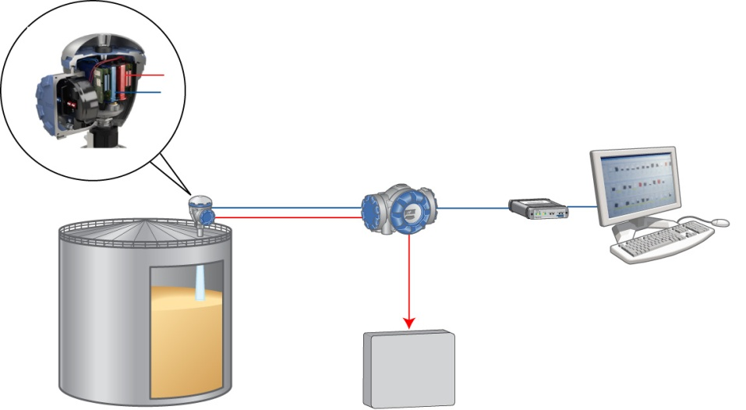
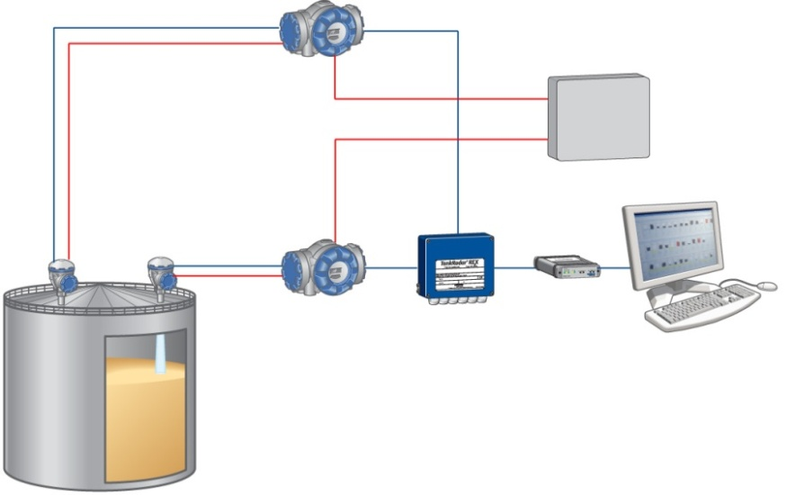
SIL 3 with Raptor
SIL 3 Alt. 1
With one 5900S with 2-in-1 and a 2410 tank hub equipped with a SIL relay output. The alarm signal is connected to Electronic Shut-Down system (ESD).
SIL 3 Alt. 2
With two 5900S and two tank hubs, each of them equipped with a SIL relay output. The alarm signals are connected to ESD.
2410 Tank Hub
Level
Alarm
SIL 2 certified relay outputs
ESD
Level x 2
2410 Tank Hub
5900S 2-in-1
5900S
Level
Alarm
SIL 3 certified relay output
Alarm
2410 Tank Hub
2160 Field Communication Unit
ESD
Notes:
SIL 3 Safety can be achieved using one 5900S with 2-in-1 option, together with a 2410 tank hub equipped with a SIL 3 relay output.
SIL 3 Safety can also be achieved using two separate 5900S gauges, each connected to a 2410 tank hub equipped with a SIL 2 relay output.
In both situations, the alarm signals are connected to an Emergency Shut-Down system (ESD)

Slide 35
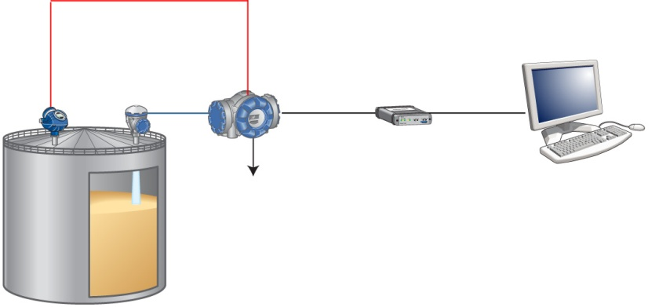

Additional High Level Alarms
If SIL 2 or SIL 3 is not required.
Level 2
Point level alarm
5300/5400
5900S
Level 1
5900S
Level
2120/2160
High level alarm: two separate and configurable relay outputs
High level alarm: two separate and configurable relay outputs
5900S for high precision level with 5300/5400 as continuous high level alarm
5900S for high precision level with 5300/5400 as continuous high level alarm
Notes:
A Raptor radar level gauge can at the same time be used bot to measure level and to detect a possible overfill. The flexible and scalable system makes it possible to combine different requirements on accuracy performance for the primary level device, with various options for a separate high level alarm device.

Slide 36





Rosemount 2120 & 2160
Vibrating fork Liquid Level Switch
”Fast drip” fork design
All liquid applications
High or low level alarm
Magnetic test point
Point level alarm
2120/2160
5900S
Level
High level alarm: two separate and configurable relay outputs
Notes:
The 2120/2160 is a liquid point level switch based on the vibrating short fork technology. The ”fast drip” fork design together with a short switching delay allow it to react more quickly and have greater sensitivity to density variations.
It is suitable for virtually all liquid applications, including coating liquids (avoid product bridging of forks), and can be used as a high or low level alarm to complement a level gauge.
Features include a complete range of process connections, housing alternatives, a choice of wetted parts materials, dry-to-wet and wet-to-dry switching functions, extended fork lengths, and hazardous area approvals.
Rosemount 2120 is TÜV-tested and approved for overfill protection according to the German WHG regulations. It is also suitable for SIL 2 applications.

Slide 37



Emulation
Compatible with other vendors
Step-by-Step modernization
Emulation in field and/or control room
Existing host system from a different vendor
Existing host system from a different vendor
TankMaster PC
Mini receiver/ FCU2165/FCU2175
Mechanical/Servo gauges from a different supplier in an existing system
2410 Tank Hub
5900S
5400
Emulation in field
Emulation in control room
Notes:
With Rex, emulation is done in the Rex gauge.
With Raptor, emulation is done in the tank hub.
Wireless TG is also a possible emulation solution.

Slide 38


Mini Receiver
Transparent interface / protocol converter / data conentrator
Integrates different vendor’s gauges
Enraf (BPM)
Whessoe (CL)
Saab (TRL/2)
Varec Mark/space
Models
Wall mount (8 ports)
Rack mount (16 ports)
Notes:
The MiniReceiver is used in Rosemount Tank Gauging systems as a transparent interface, protocol converter and data concentrator. It replaces in functionality the FCU-2165 / FCU-2175 units. The main purpose is to integrate different vendor’s gauges using one transparent interface.

Slide 39





Redundancy
TankMaster Client PCs
TankMaster Servers
2180 Field Bus Modems
2160/65/75 Field Communication Units
2410 Tank Hubs
Two alternatives for level
Pressure x 2
2-in-1
Notes:
The Rosemount TG system supports several possible redundancy designs, from the server room and control room, to the field units on the tank.
PCs, groupbuses, fbm’s, fcu’s, tank hubs etc.

Slide 40


System Integration
Wireless tank gauging system (Raptor, Rex or Pro)
Smart Wireless Gateway
2160/2165/2175 Field Communication Unit
TankMaster for inventory management
5900S-based system
2180 Field Bus Modem
TankRadar Rex or Pro tank gauging system
5300/5400-based system
Tank Gauging system from a different vendor (servo level gauge based)
Notes:
The Raptor system can have a large number of configuration combinations. It can incorporate both 5900S, and 5300/5400 system configuration networks with previous generations of Rosemount TankRadar gauges (2900 TRL2, Rex, Pro) and even mechanical servo gauges.
Wired and wireless networks can co-exist within the same system. This flexibility enables a step-by-step upgrade of a tank gauging system.

Slide 41

Foundation Fieldbus communication
Delta V host system
375/475 Field Communicator
FOUNDATIONTM fieldbus Tank Bus
2240S with 565/765
5900S
3051S
Notes:
Open FF is the next step in the Raptor system, where the 5900S, the 2240S and display can communicate directly with a Delta V host system without the tank hub in between.
41

Slide 42

HOST communication
Host communication to Raptor system via:
TankMaster
Field Communication Unit
Tank Hub
Smart Wireless Gateway
DCS / Host
2160/65/75 Field Communication Unit
RS485 or RS232
TankMaster PC
Tankbus
Modbus
USB or RS232
2410 Tank Hub
TRL2
OPC
Modbus
RS485
Modbus
Notes:
There are many different ways to connect to a HOST:
Via TankMaster
Via FCU direct to HOST
Directly from Tank hub to host
Via the Smart Wireless Gateway
The recommended way is through TankMaster as this gives more inventory calculations.

Slide 43



Configuration Tools
Configuration tools for Raptor:
Rosemount TankMaster
AMSTM Suite
DeltaV®
Rosemount Field Communicator
Notes:
Recommended configuration tool for Raptor and Rex is TankMaster. Even though some configuration may be done with the help of AMS Suite, Delta V and even a Field communicator, TankMaster is designed for configuration of these devices and will give you the ultimate possibilities from the system.

Slide 44


Field Communicator
Handheld communicator
Universal - HART® and FF
Intrinsically Safe
Robust and reliable
Navigation Keys
Enter key
Tab key
Function Key
Alphanumeric Keys
Backlight adjustment key

Slide 45
Rosemount Raptor System
THUM
2240S
5900S
5400
5900S
2240S
5400
5900S
2410
644
Smart Wireless Gateway
3051S
5300
644
2160/65/75 Field Communication Unit
2230
2410
2410
2410
2180 Field Bus Modem
2240S Multi-input Temperature Transmitter
5900S Radar Level Gauge
5300/5400 Radar Level Transmitter
Field Communicator
TankMater PC Workstation in Network
2410 Tank Hub
TankMaster.net
2230 Graphical Field Display
Smart Wireless THUM Adapter
644 Temperature Transmitter with Single Point Temperature Sensor
3051S Pressure Transmitter
2120/2160
Liquid Level switch

Slide 46
Rosemount Rex/Pro System

